Slide 1
AIRLINE PASSANGER SATISFACTION PREDICTION
(GROUP-14)
Janita Bose -- A0262823E
Nithesh Reddy– A0232779R
Asok Kaushik -- A0262739U
Nandhini Selvaganapathy – A0262710N

Slide 2
Background
There are a lot of airline service providers (ASP).
The customer satisfaction is always in top priority to improve the airline revenue.
The satisfaction of the customer includes many factors such as :
Online boarding
Seat comfort
Inflight entertainment
On-board service
Food and drink
Cleanliness etc.…
In order to attract customer, we need to get feedback from them and need to concentrate on dissatisfied list to achieve their satisfaction level.

Slide 3

OBJECTIVE:
To understand the contentment of airline passengers which impacts the business performance and its future profitability
To identify the Best Machine Learning Model and Strategy to forecasting the customer satisfaction and improve the Airline profit, respectively.

Slide 4

Workflow Diagram

Slide 5
Business Understanding
Strategy to attract the dissatisfied Customers
Deployment
Collect new data
Implementing the best performing model
Data Understanding
Evaluation
Exploratory Data Analysis with Various plots
Choosing right metrics as of business understanding
Data Preparation
Modelling
One Hot Encoding
Ordinal Encoding
Multiple models experimented

Slide 6

COST BENEFIT MATRIX

Slide 7
Cost Benefit Matrix
Satisfied customers is retained
Unnecessary marketing funds spending on Satisfied customers
 |  | PREDICTED
 |  | Satisfied Customer | Unsatisfied Customer
ACTUAL | Satisfied Customer | 100$ | 70$
 | Unsatisfied Customer | 0$ | -30$
Unsuccessful marketing on Unsatisfied customers who choses to leave
Unsatisfied customers leaves

Slide 8

MODELS AND RESULTS

Slide 9
LIST OF MODELS
K-Nearest Neighbor Algorithm
Random Forest
Gradient Boost
Logistic regression
Decision trees
Support Vector Machine

Slide 10
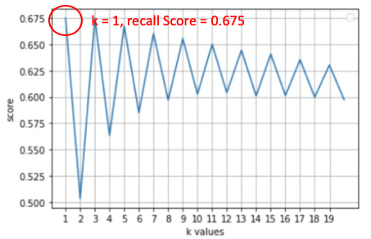
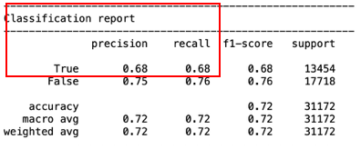
K-Nearest Neighbor Algorithm
Finding the best parameter
Classification Report with k=2
Normalized Confusion Matrix
Cost Benefit Matrix
0.29 | 0.14
0.14 | 0.43
100 | 70
0 | -30
n_neighbors' parameter is evaluated from 1 to 20
k=1 is chosen as it shows the highest recall score of 0.68
Expected Value Framework
Expected Value calculated is 26.04

Slide 11
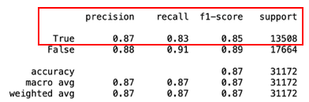
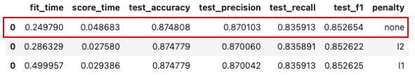
Logistic Regression
Finding the best parameter
Classification Report with k=8
The model was evaluated with penalty parameter to L1 with is Lasso and L2 which is Ridge but overall observed no improvements and not much difference from penalty to be ‘none’
the highest precision score of 0.87
Normalized Confusion Matrix
Cost Benefit Matrix
0.36 | 0.07
0.05 | 0.51
100 | 70
0 | -30
Expected Value Framework
Expected Value calculated is 25.76

Slide 12
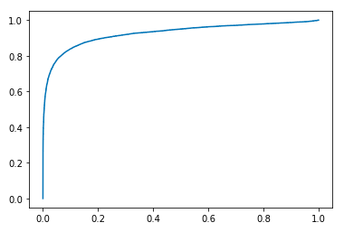
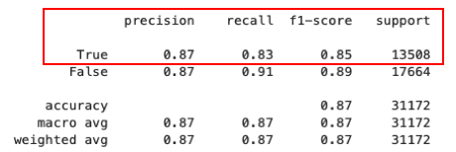
Support Vector Machine
Finding the best parameter
Classification Report with c=0.1
Normalized Confusion Matrix
Cost Benefit Matrix
0.36 | 0.07
0.05 | 0.51
100 | 70
0 | -30
The model was evaluated with C(error penalty) parameter value with 0.01, 0.1, 1 and 10
c=0.1 is observed to be the best parameter with the recall value to be around 0.83.
ROC score 0.93 and starts saturating from 0.1 value
Expected Value Framework
Expected Value calculated is 25.70

Slide 13
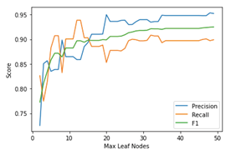
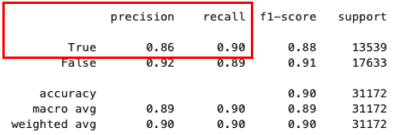
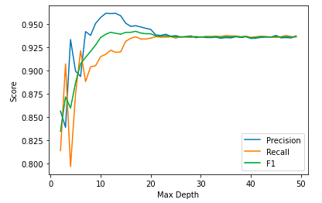
Decision Tree
Max Leaves Evaluation
Classification Report with d=12
Normalized Confusion Matrix
Cost Benefit Matrix
Max Depth Evaluation
0.39 | 0.04
0.06 | 0.50
100 | 70
0 | -30
Expected Value Framework
Expected Value calculated is 27.00

Slide 14
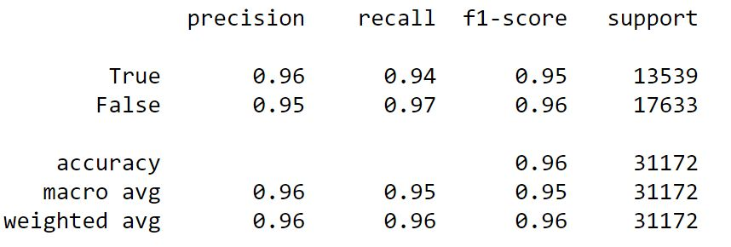
Gradient Boost
Finding the best parameter
Classification Report with k=2
The model was evaluated various combinations
max_depth (1,3,5,7)
learning_rate(0.01,0.1,1)
n_estimators(50,100,500)
Best Parameters
max_depth=5
learning_rate = 1
n_estimators = 50
Recall value is 0.94.
Normalized Confusion Matrix
Cost Benefit Matrix
0.40 | 0.03
0.02 | 0.55
100 | 70
0 | -30
Expected Value Framework
Expected Value calculated is 26.24

Slide 15
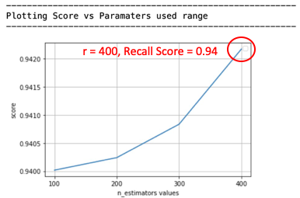
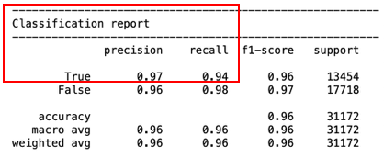
Random Forest Model
Finding the best parameter
Classification Report with k=8
Normalized Confusion Matrix
Cost Benefit Matrix
0.41 | 0.02
0.01 | 0.56
100 | 70
0 | -30
n_estimators parameter is evaluated from 100 to 500
r=200 is chosen as it shows the highest recall score of 0.94
Expected Value Framework
Expected Value calculated is 25.70

Slide 16
Comparison of Models
 | Logistic Regression | SVC | Random Forest | KNN | Decision Tree | Gradient Boost
Precision | 0.87 | 0.87 | 0.97 | 0.68 | 0.86 | 0.96
Recall | 0.83 | 0.83 | 0.94 | 0.68 | 0.90 | 0.94
*Expected Value | 25.76 | 25.70 | 25.70 | 26.04 | 27.00 | 26.24
After evaluating the models, high recall score is being achieved by Random Forest Model and this model is best to cut down on the known losses for the company and expected cost benefit associated with this model is 25.70
After Deployment
 | Logistic Regression | SVC | Random Forest | KNN | Decision Tree | Gradient Boost
Precision | 0.87 | 0.87 | 0.97 | 0.69 | 0.46 | 0.96
Recall | 0.83 | 0.83 | 0.94 | 0.67 | 0.97 | 0.95
*Expected Value | 26.53 | 26.47 | 26.65 | 26.70 | 41.8 | 26.93

Slide 17
Business Application and Conclusion
Having high Recall will be more important for our business problem. To correctly identify the crucial factors leading to customer satisfaction, the model prediction of the positive class, ‘Satisfied’ needs to be very reliable.
These models being experimented while aiming for high recall help the business to minimize their expenses on distributing the coupons to satisfied customers who are predicted to be unsatisfied wrongly
The deployed model predicts the Satisfaction level of customers based on the survey feedback taken in the end of the journey and would give an insight to Airline management on the percentage of customers choosing back to fly back again.
The Airline management can also take steps in decreasing the number of annoyed customers by providing marketing coupons. The deployed model needs to be monitored constantly with performance metrics and need to be manually retrained.

Slide 18
Thank You
For
Travelling with us

